Slide 1
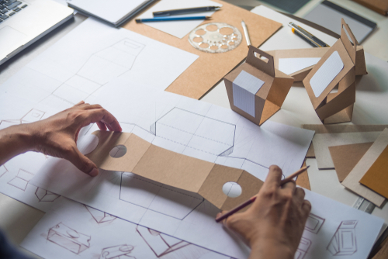
higher Design & Manufacture
Design Factors - Introduction

Slide 2


Learning intentions & success criteria
Learning Intentions
Introduction and overview of the key design factors associated with designing products.
Success Criteria
Understand what a design factor is.
State the key design factors.
Explain each of the key design factors.

Slide 3
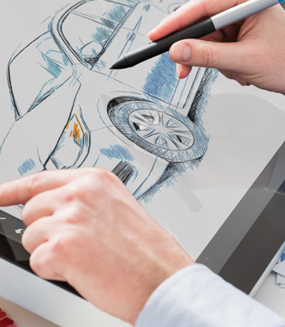
What are design factors?
Design Factors are all the things that will influence the design of a product, for example;
  What it does will influence the product.
  How it looks will influence the product
  The user’s size and strength will influence the product
  The user’s interests will influence the product
  The materials chosen will influence the product
  How long the product will last will influence the product

Slide 4
The 5 main design factors
There are a huge number of factors that could influence a product’s design and change anything from its colour to its weight.
The 5 main design factors are:
  Function
  Aesthetics
  Ergonomics
  Market
  Performance

Slide 5
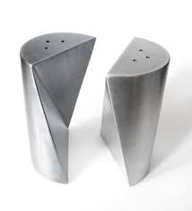
function
A product’s function is the job it’s designed to do.
Without a function a product is just an object – it would have no purpose.
Example: salt and pepper dispenser.
Function: to apply salt and pepper to food in controlled quantities.

Slide 6

Primary and secondary function
The PRIMARY function of a product is the main operation a product performs. For example:
  A clock displays the time.
  A pair of scissors cuts material.
The SECONDARY function of a product is another operation a product can perform. For example:
  A camera in a phone (functional)
  Aesthetically improves the environment it is placed in (subtle)

Slide 7
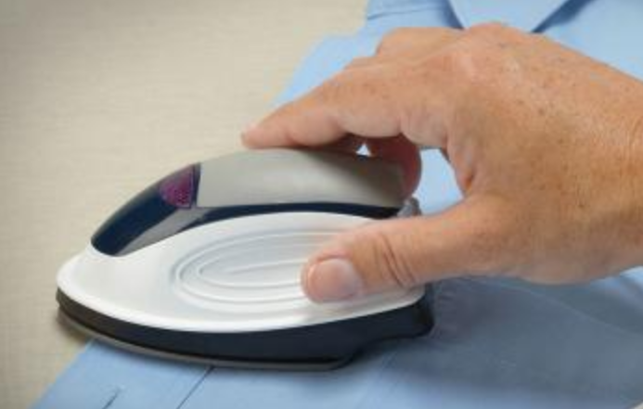
question
An electric iron and a travel iron have an identical primary function.
What are the key differences between these products?
Possible Answers:
  Portability
  Size/compact
  Adjustable/flat-pack
  Weight
  Capacity for water

Slide 8
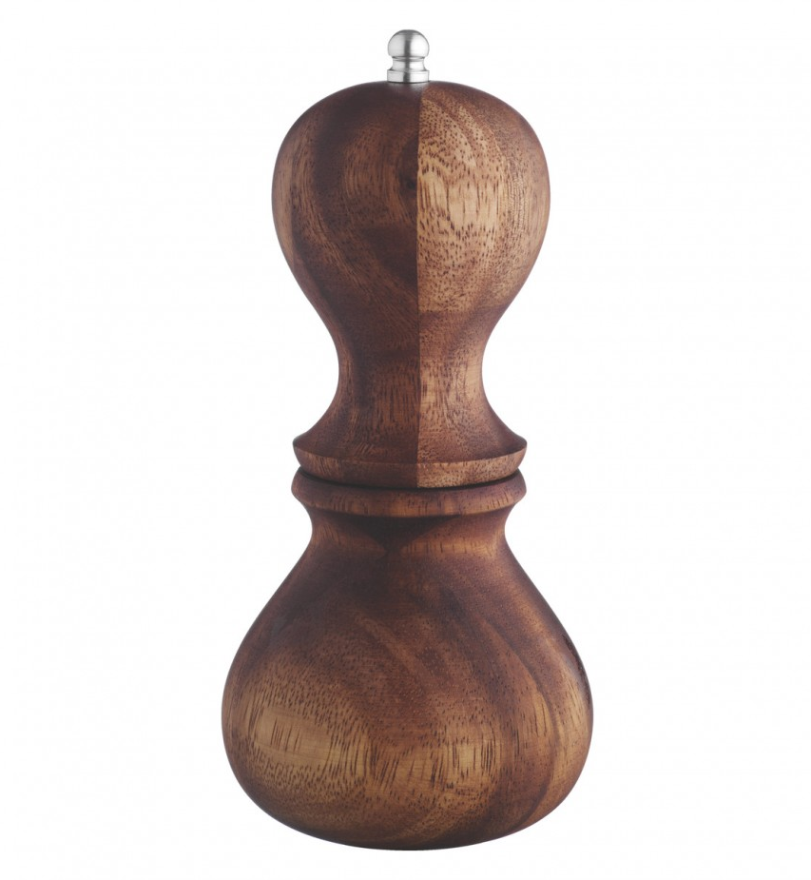
The impact of function
The Pepper Mill’s primary function is to dispense pepper. In order to do this;
  The mill must be twisted.
  To twist the mill the user must be able to comfortably hold and twist it.
  The mill must hold pepper in a hygienic way.
  The Mill will stand on its own for storage.
  The mill will have a subtle secondary function of providing decoration to a table.

Slide 9
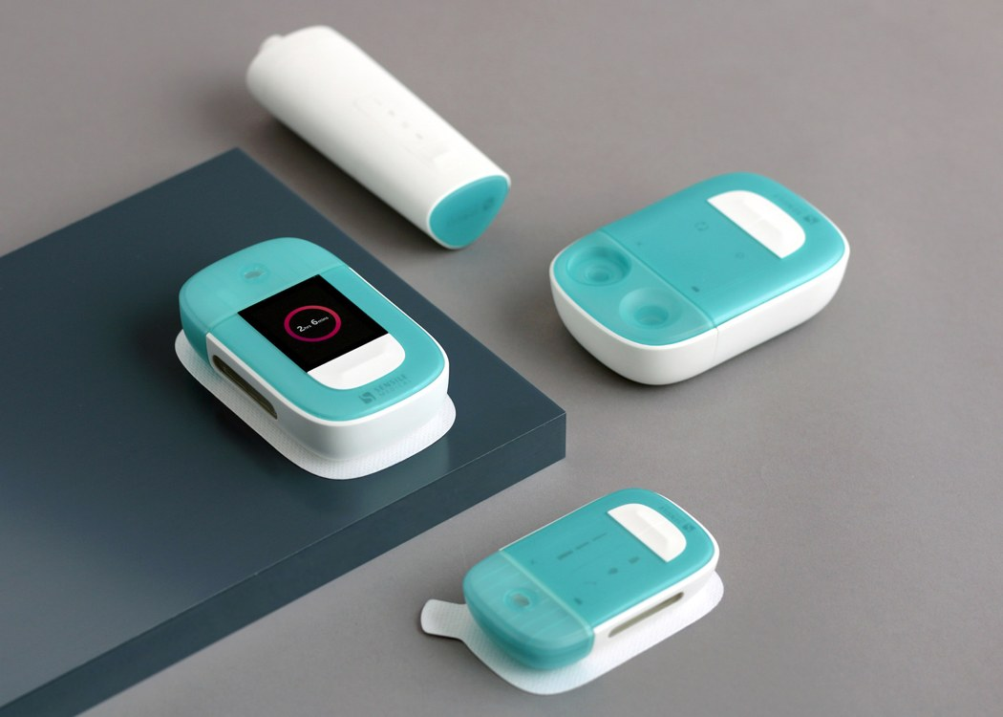
aesthetics
Aesthetics focusses on the way a product looks.
There are many different factors that influence aesthetics…
  Line/Shape/Form
  Colour
  Size/Proportion
  Contrast/Harmony
  Fashion/Style
  Materials
  Texture

Slide 10
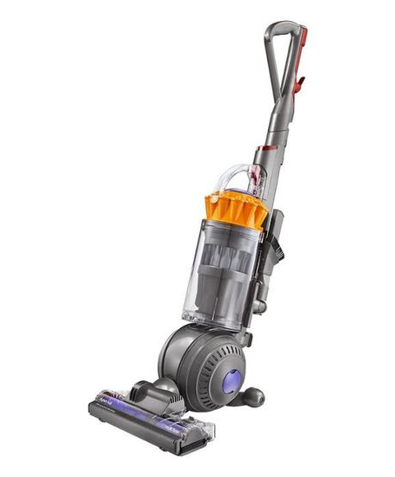
aesthetics
Aesthetics has a big impact on how people perceive a product.
For example…
  The form of the Dyson makes it look well built and technologically advanced.
  The grey colour makes it appear machine-like suggesting it will perform efficiently.
  The yellow contrasts and draws attention to the key components of the product.
  The transparent material surrounding the cyclone draws your focus to the central component.
  The product looks balanced and poised suggesting it is easy to manoeuvre.

Slide 11
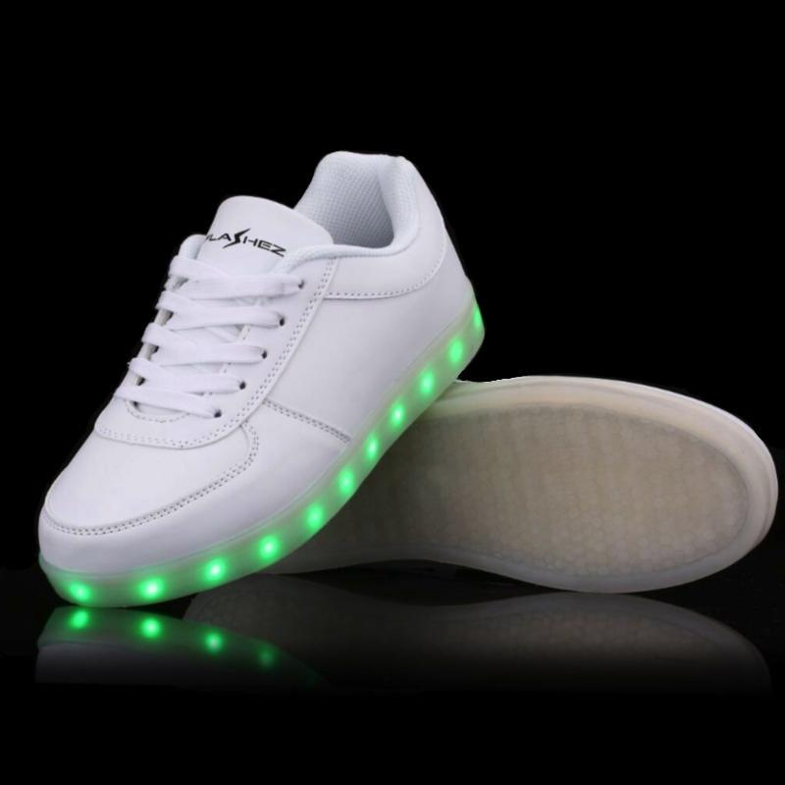
question
Most shoes and trainers share an identical function – to protect and support your feet.
How is your buying decision influenced by aesthetics?
Possible answers:
  Shape
  Colour options/harmony/contrast
  Current trends/popularity
  Branding
  Appealing appearance
  Appealing style
  Level of comfort

Slide 12
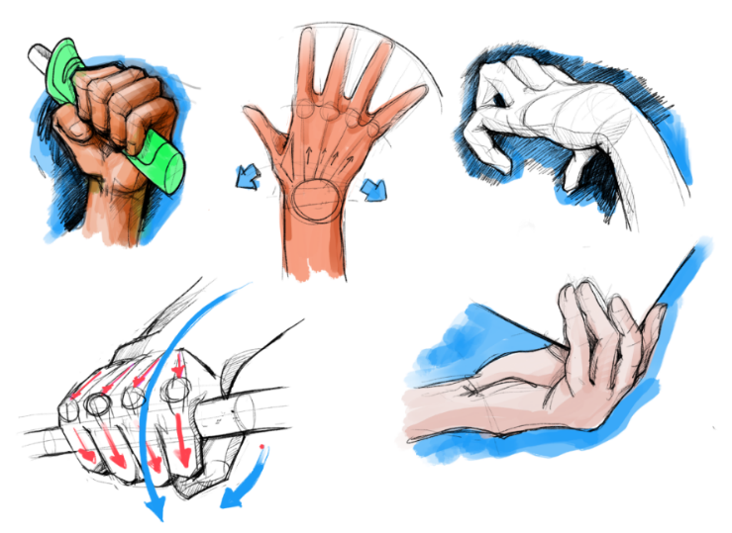
ergonomics
Ergonomics is all about the way humans interact with products and their environment.
Ergonomics is about finding ways of making products more useable or user-friendly.
It can be divided into three main areas…
  Anthropometrics
  Physiology
  Psychology

Slide 13
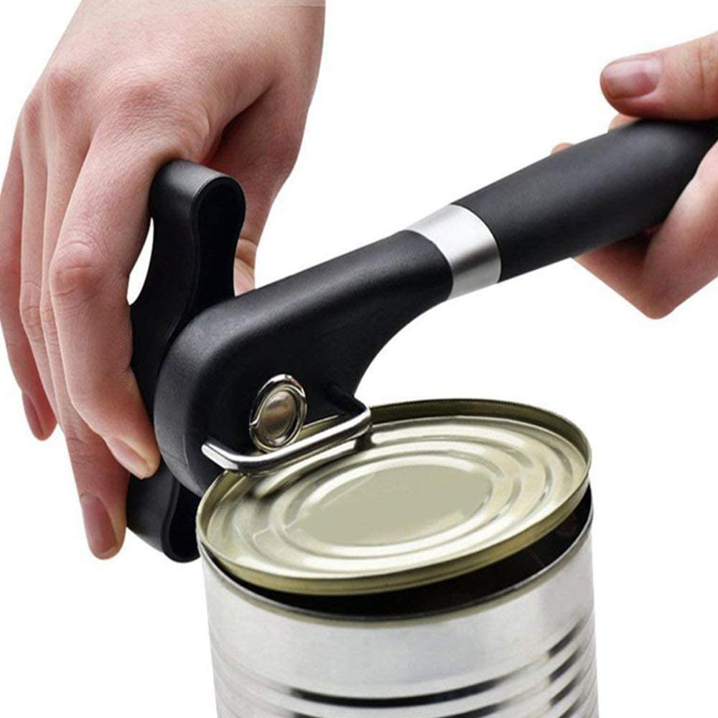
ergonomics
Ergonomics can…
  Make products more appealing to use.
  Make products more accessible for users.
  Reduce the fatigue of a user.
  Increase the productivity of a user.

Slide 14
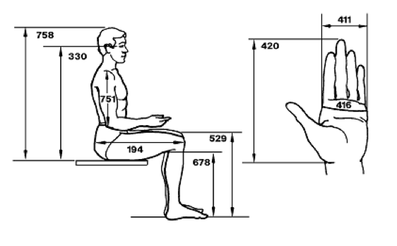
anthropometrics
Anthropometrics deals with the measurement of the human body.
We use anthropometric data to make products suitable for the majority of users.
We use anthropometric data to design for a specific age, sex/gender of percentile group.

Slide 15
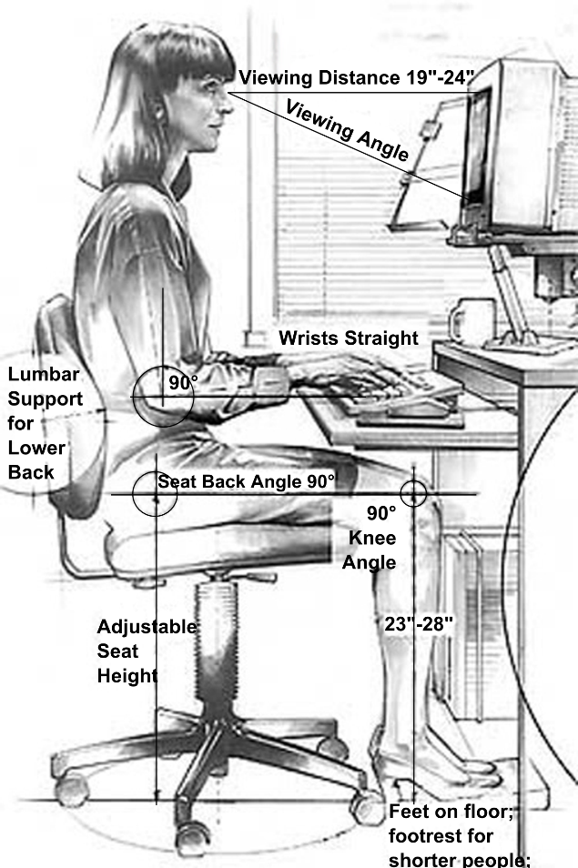
anthropometrics
We use anthropometrics because we want to design products that are suitable for the largest number of users.
We use percentiles to help decide what sizes to use.

Slide 16
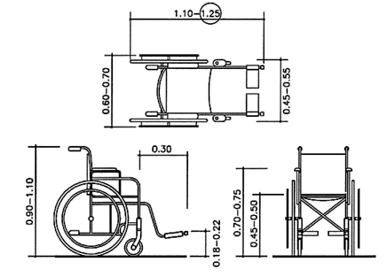
anthropometrics
For example, a door’s height must include the 95th percentile, otherwise taller people would be disadvantaged. The door’s width is determined by access for disabled people with wheelchairs.
In contrast, a chair’s seat height from the floor would be designed for the 50th percentile to ensure most people can sit comfortably and rest their feet on the floor.

Slide 17
anthropometrics
The average human is the 50th percentile, the smallest in the 5th and the tallest in the 95th.
Number of people
5th Percentile
50th Percentile
95th Percentile

Slide 18
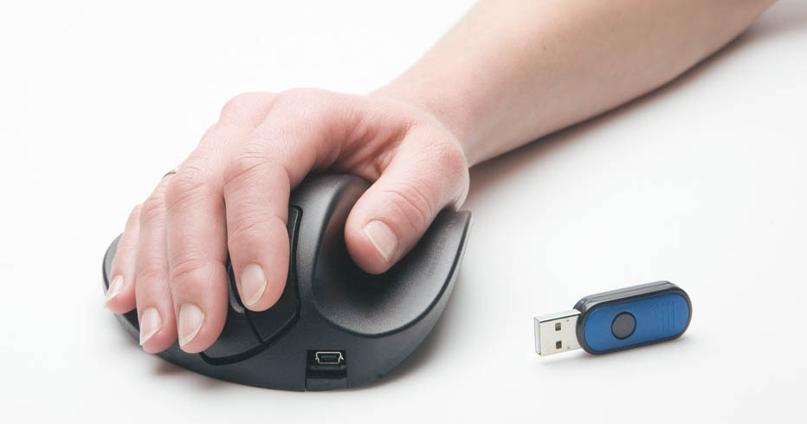
physiology
Physiology is how we physically interact with a product – lift/push/pull/twist/open/sit etc.
Our physical abilities are effected by age, strength, fitness, dexterity etc.
Products have to be made in a way that allow us to use them without causing physical strain or injury.

Slide 19
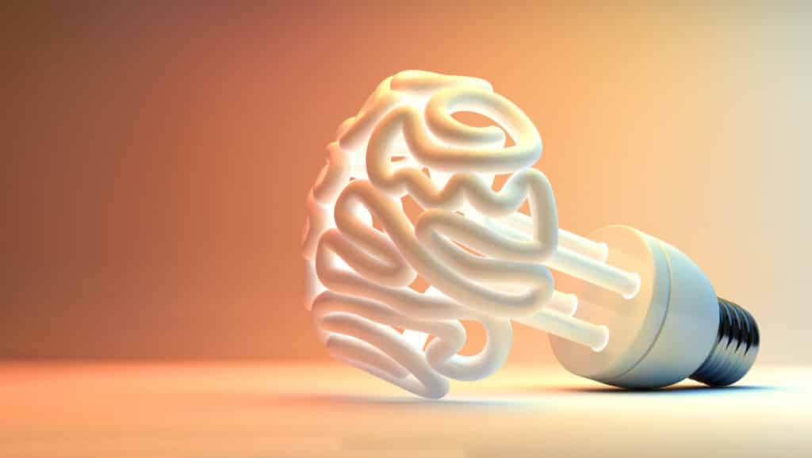
psychology
Psychology is about the human mind and in ergonomics its how products make us feel or what they make us think.
Psychology and aesthetics sometimes overlap.
Colours can generate certain feelings or emotions.
Textures can tell us about the quality or safety of the product.

Slide 20

performance
Performance is about how well a product fulfils its purpose – how it performs and how well it works.
It can be divided into a few main areas;
  Safety is a product safe to use
  Durability will the product stand up to frequent use
  Ease of Maintenance can the product easily be kept in working order
  Materials & Manufacturing are the materials suitable? What processes will be used?

Slide 21

market
Market is everything to do with who will buy the product, where/when it will be sold, how much it will cost etc.
Target Market is the group of people who the product will be aimed at. The target Market is influenced by:
  Age
  Geographical location
  Income
  Interests
  Lifestyle
  Cultural
  Religion
  Need/wants of consumers
  Current trends

Slide 22
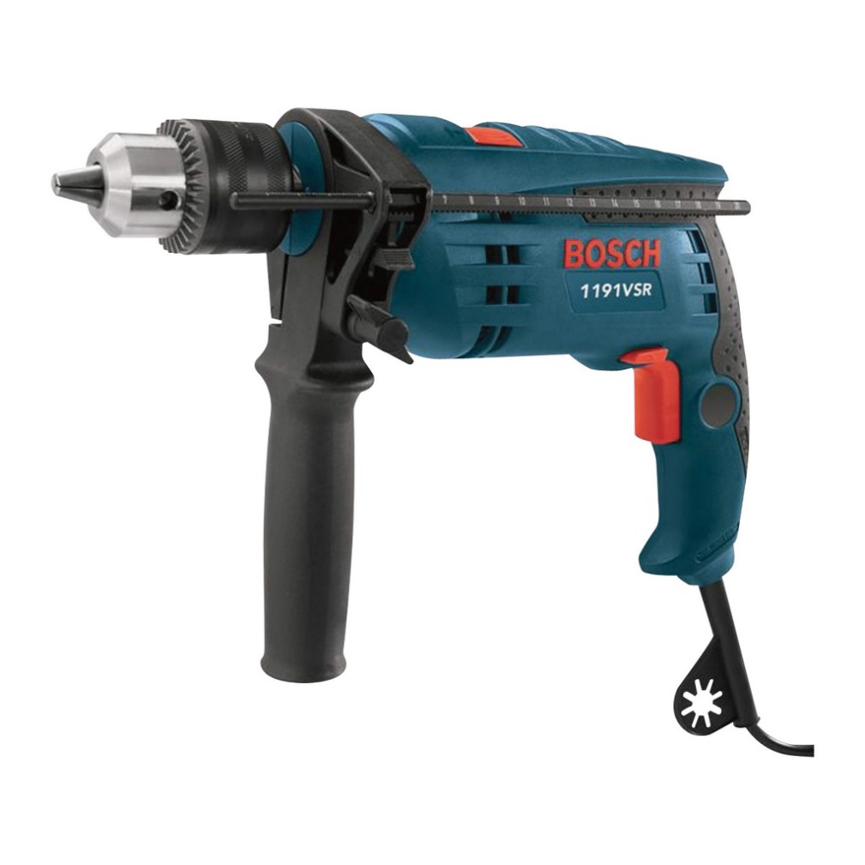
Activity 1
Use the Design Factors to help carry out a DESIGN ANALYSIS.
Use the Design Factors to help carry out a design analysis. How have each of these affected the design of the drill.
Write in paragraphs on the sheet provided to describe and explain your design analysis.
FUNCTION
AESTHETICS
ERGONOMICS
PERFORMANCE
MARKET

Slide 23
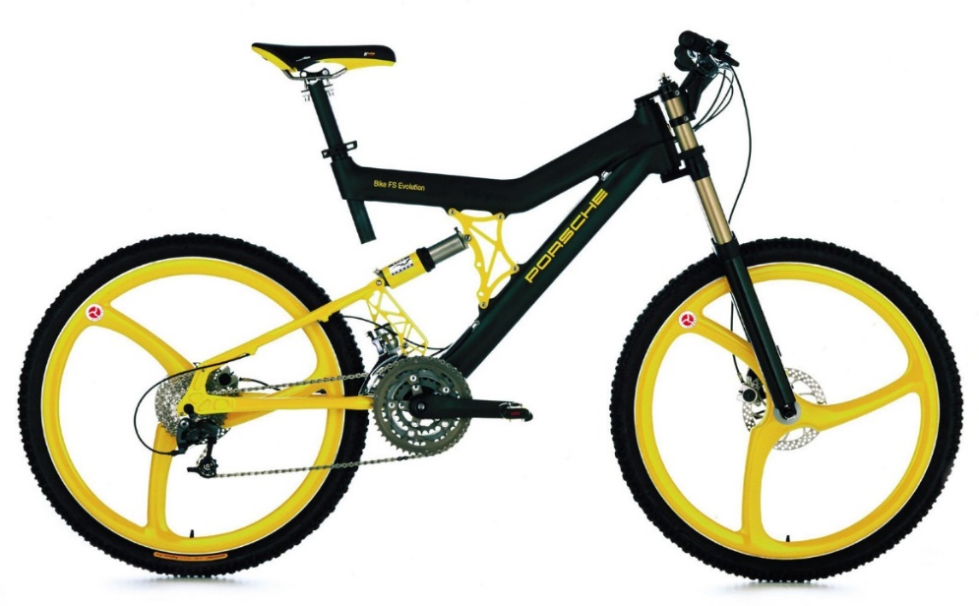
Activity 2
Use the Design Factors to help carry out a DESIGN ANALYSIS.
Use the Design Factors to help carry out a design analysis. How have each of these affected the design of the bike.
Write in paragraphs on the sheet provided to describe and explain your design analysis.
FUNCTION
AESTHETICS
ERGONOMICS
PERFORMANCE
MARKET

